Slide 1
AI-BASED NETWORK INTRUSION DETECTION SYSTEM
BY
NAME: PRIYADARSHINY DAS
AICTE ID (VOIS INTERNSHIP APPLY ID): APPLY_1764363743692a0ddf007b0
STREAM: Computer Science And Engineering- Cyber Security
NATIONAL INTERNSHIP PORTAL STUDENT ID: STU6761195c3ea191734416732

Slide 2

PROBLEM STATEMENT
In today’s hyper-connected world, unauthorized and unethical network intrusions pose a grave danger to everyone. These attacks, ranging from ransomware to distributed denial of service, constantly harm millions of individuals and thousands of organizations by compromising sensitive information and vital services. Current security systems struggle to handle the huge volume and complexity of modern network data, making it hard to spot subtle attacks before major damage occurs. As a result, victims suffer severe financial losses, irreparable damage to reputation, and widespread loss of public trust.

Slide 3
Project Description
This is a project to classify incoming network traffic as either safe (0) or malicious (1) using a trained Random Forest Classification model. It is implemented as an interactive dashboard to show key metrics for the dataset corresponding to the mode and flag network packets as an attack based on the packet details (user inputs).
Language: Python. App type: Streamlit app. Deployment: Streamlit Community Cloud.
Goal: To detect potential cyberattacks (like DDoS or port scans) by analyzing key network packet characteristics.
Mode of operation: Simulation (using synthetic data) and Real-time (downloading a real-time dataset via URL).
Core algorithm: Uses the Random Forest Classifier for supervised machine learning and classification.
Key features:-
Interactive training: Users can start the model training process and adjust the mode, number of decision trees, and percentage of training data.
Performance reporting: Displays live metrics including training and test accuracies, mean errors, detailed classification reports, and visual confusion matrices.
Live simulator: An interactive section allows users to input specific packet parameters (e.g., Destination Port, Flow Duration) and receive an instant prediction from the trained model.
Traffic features used: The model trains on five network features, namely 'Destination Port', 'Flow Duration (ms)', 'Total Fwd Packets', 'Packet Length Mean', and 'Active Mean'.

Slide 4
WHO ARE THE END USERS?
The potential end users for this project are primarily individuals and teams responsible for network security, analysis, and system development.
Security Analysts (SOC Team): These are the primary operational users. They would use the dashboard to view real-time predictions and check the metrics to quickly assess the network's security status and validate the model's alerts before escalating an incident.
Data Scientists/Machine Learning Engineers: They would use the dashboard's interactive features (number of trees, training data size, and mode) and the detailed performance metrics (detected threats, accuracy scores, mean errors, classification reports, and confusion matrices) to train, tune, validate, and compare different iterations of the Random Forest model.
Network Engineers/Administrators: They would primarily use the dashboard to gain high-level visibility into network traffic patterns, especially using the Live Traffic Simulator to test how specific, known- suspicious packet characteristics would be flagged by the AI.
Project Managers/Stakeholders: They would review the high-level performance metrics (Test Accuracy, Threats Detected) to assess the effectiveness and readiness of the intrusion detection capability.
Students/Researchers: Given its dashboard format and simulation mode, it is an excellent educational or research tool for those studying machine learning in cybersecurity, allowing them to easily load data, train, and test an NIDS model without complex setup.

Slide 5


Technology Used
LIBRARIES:-
Numpy Pandas Matplotlib Scikit- learn Requests IO
Streamlit
LANGUAGE: Python
ALGORITHM FOR MACHINE LEARNING
AND CLASSIFICATION: Random Forest Classifier
DEPLOYMENT: Streamlit Community Cloud
DATASET STORAGE: Google Drive
DATASETS FOR TRAINING AND TESTING:-
Instantaneous simulated dataset Intrusion detection evaluation dataset (CIC-IDS2017): Friday-WorkingHours- Afternoon-DDos.pcap_ISCX.csv
VERSION CONTROL SYSTEM: Git
PROJECT CODE STORAGE: GitHub
IDE: Visual Studio Code
KEY METRICS EVALUATION:-
Accuracy score Mean Absolute Error
Mean Squared
Error Classification Report Confusion Matrix

Slide 6
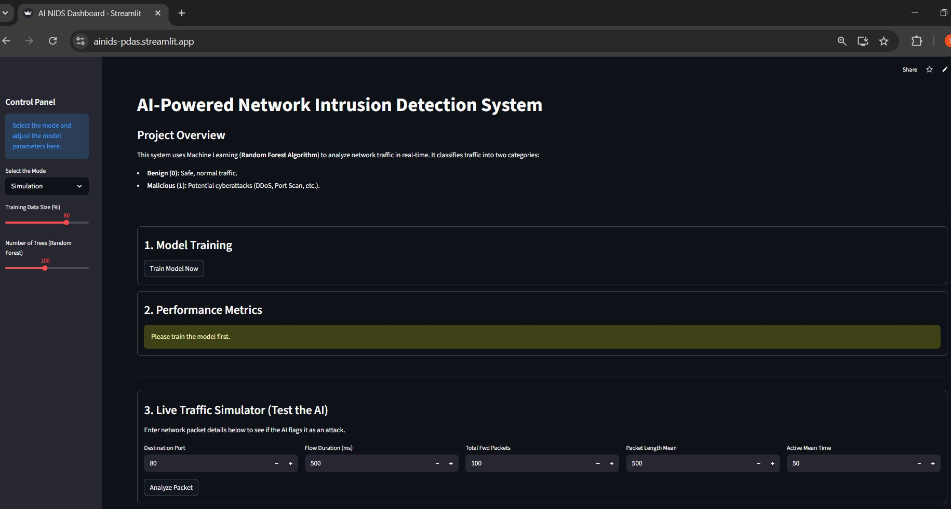
RESULTS
App link: ainids-pdas.streamlit.app

Slide 7
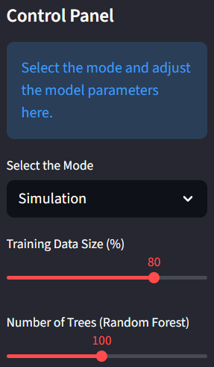
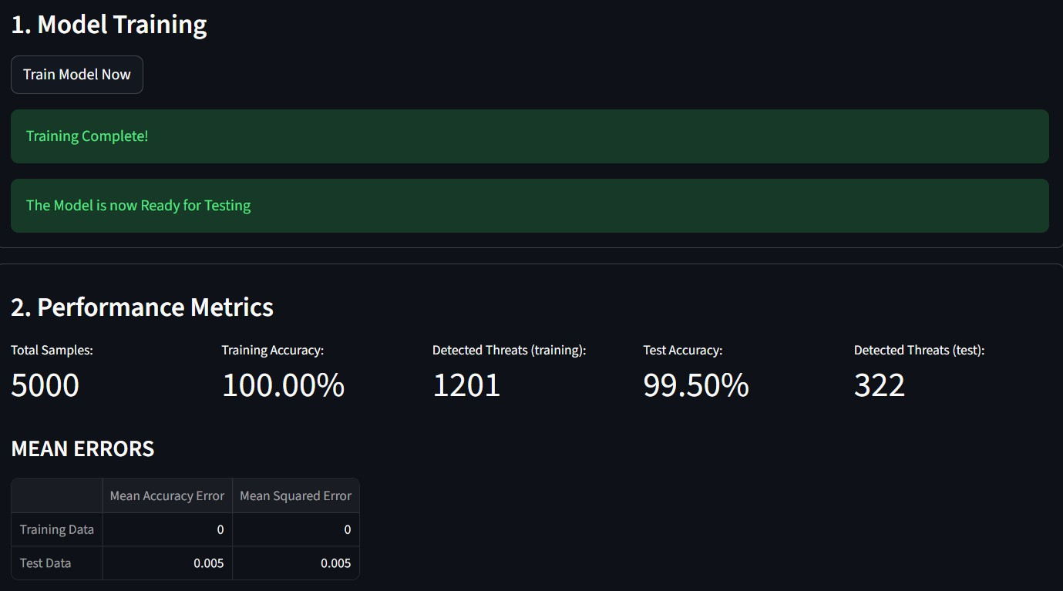
MODE: Simulation TRAINING DATA SIZE: 80%
NUMBER OF TREES (RANDOM FOREST): 100

Slide 8
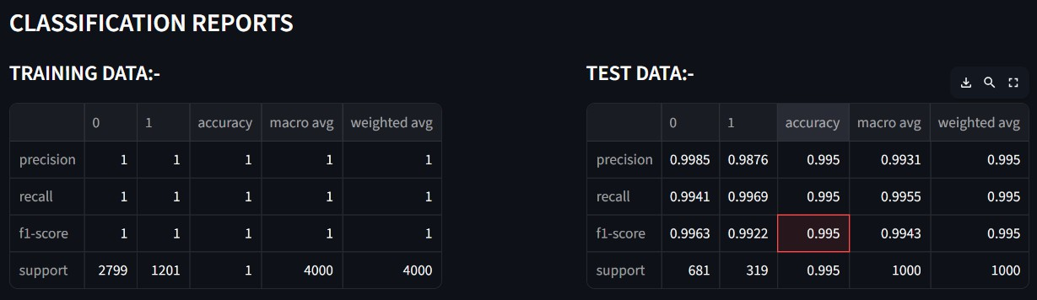
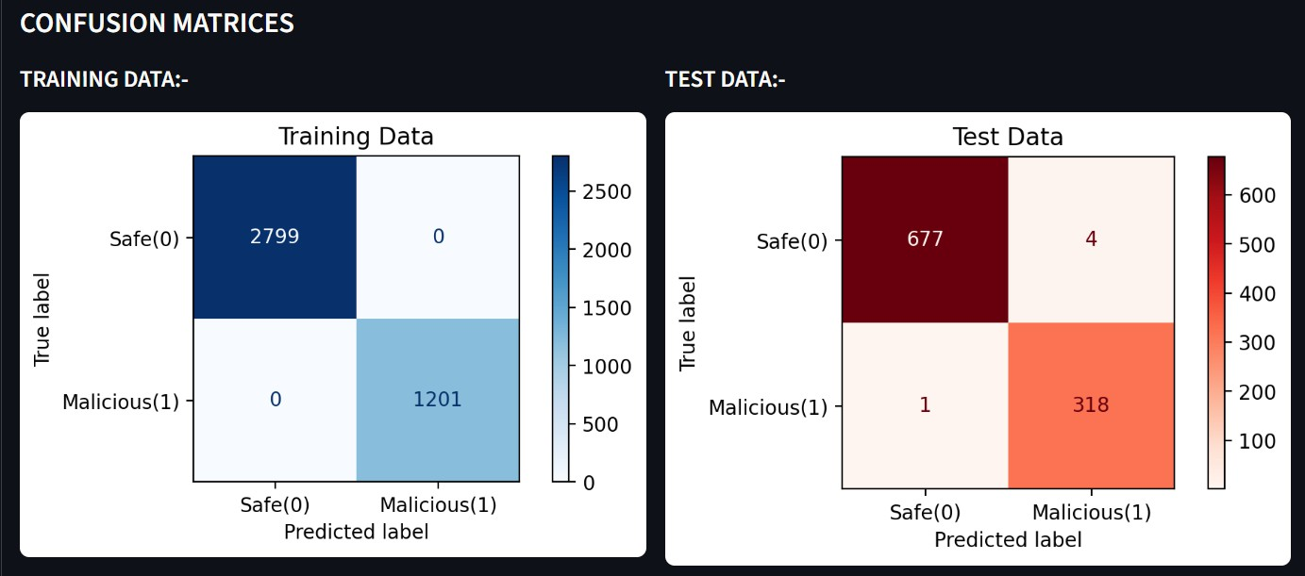
MODE: Simulation TRAINING DATA SIZE: 80% NUMBER OF TREES (RANDOM FOREST): 100

Slide 9
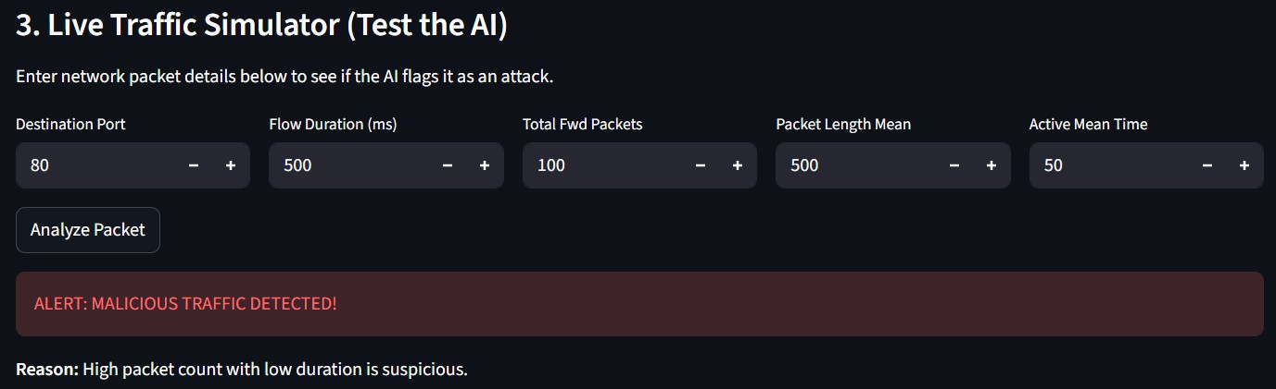
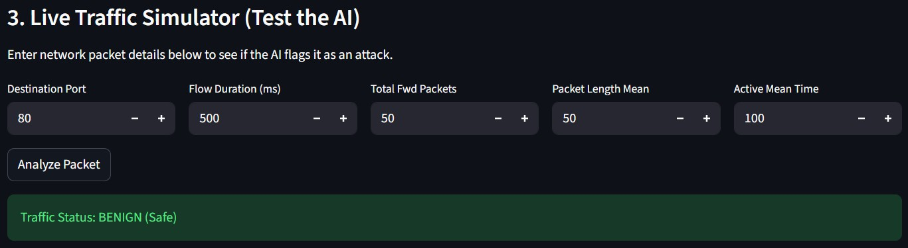
NUMBER OF TREES (RANDOM FOREST): 100
MODE: Simulation
TRAINING DATA SIZE: 80%

Slide 10
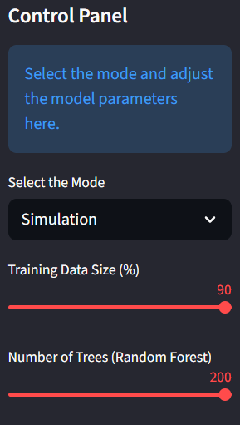
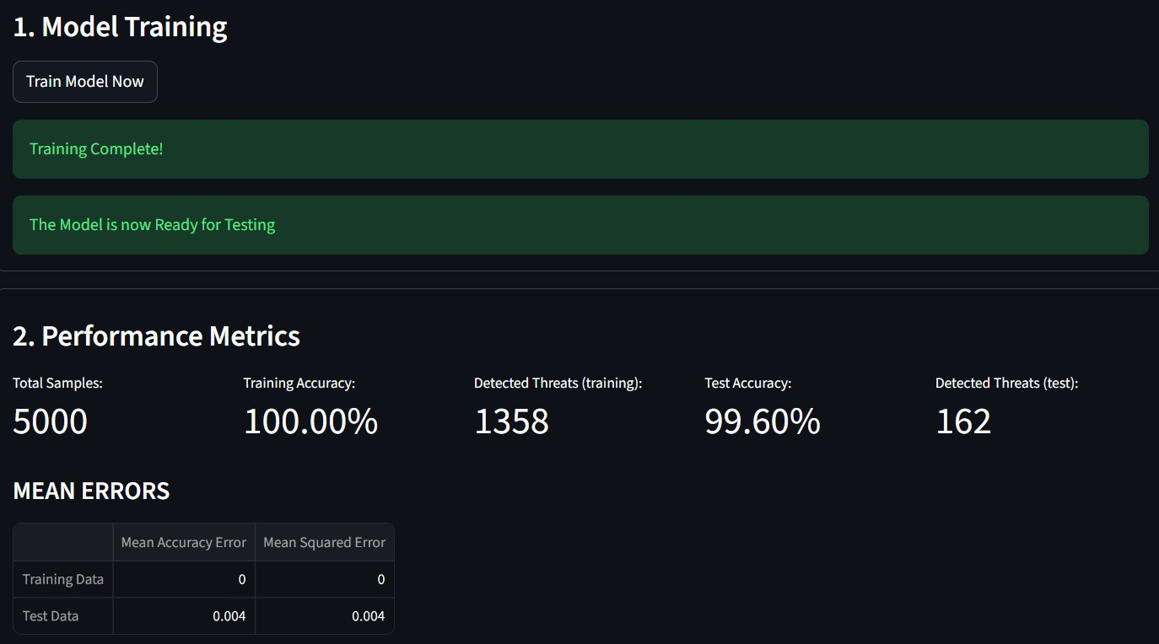
MODE: Simulation TRAINING DATA SIZE: 90%
NUMBER OF TREES (RANDOM FOREST): 200

Slide 11
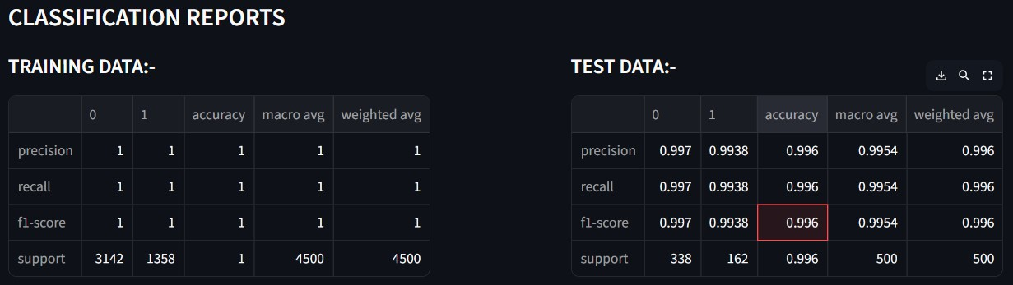
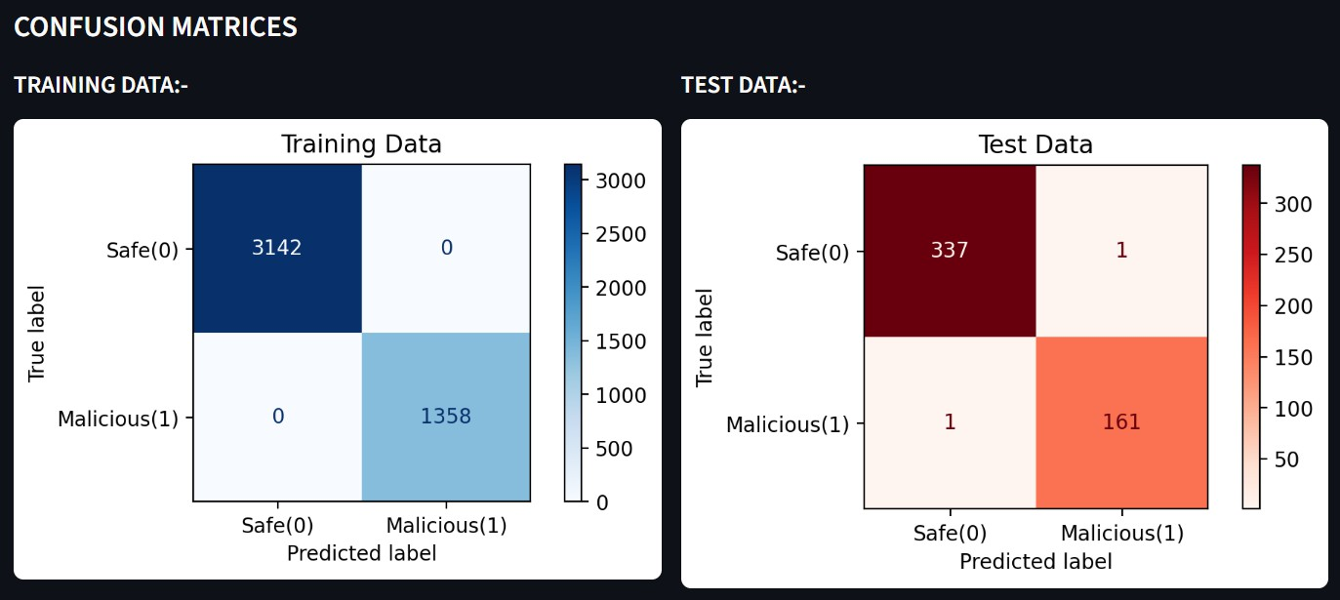
MODE:
Simulation TRAINING DATA SIZE: 90% NUMBER OF TREES (RANDOM FOREST): 200

Slide 12
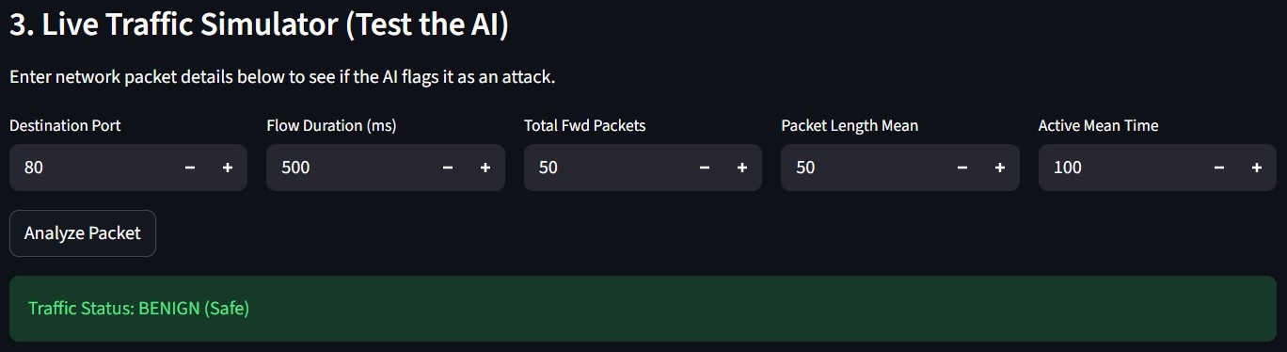
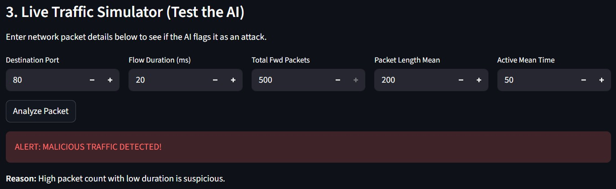
NUMBER OF TREES (RANDOM FOREST): 200
MODE: Simulation
TRAINING DATA SIZE: 90%

Slide 13

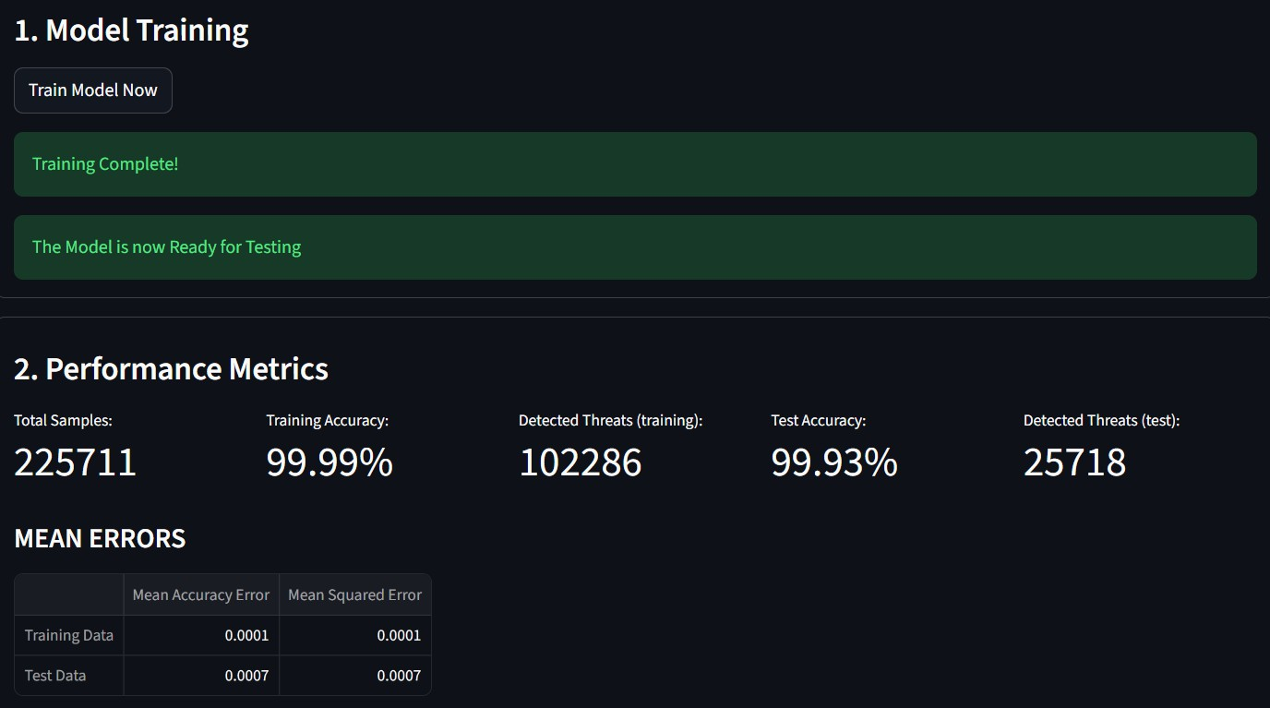
MODE: Real-time TRAINING DATA SIZE: 80%
NUMBER OF TREES (RANDOM FOREST): 100

Slide 14
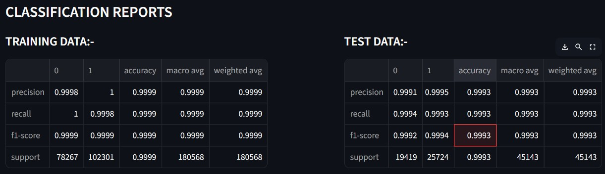
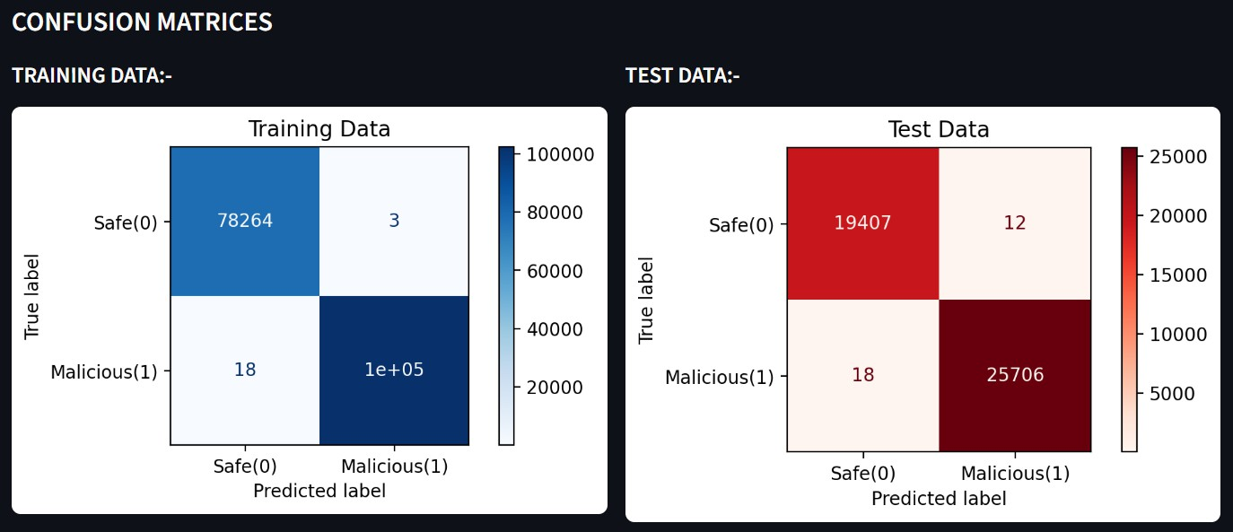
MODE: Real- time TRAINING DATA SIZE: 80% NUMBER OF TREES (RANDOM
FOREST): 100

Slide 15
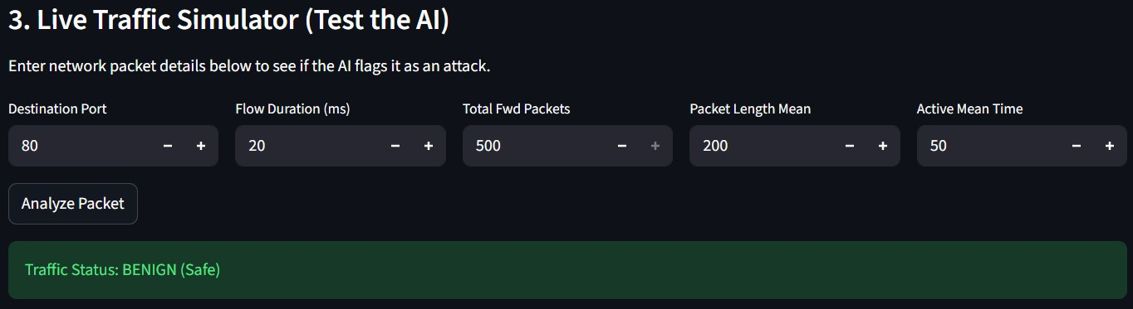
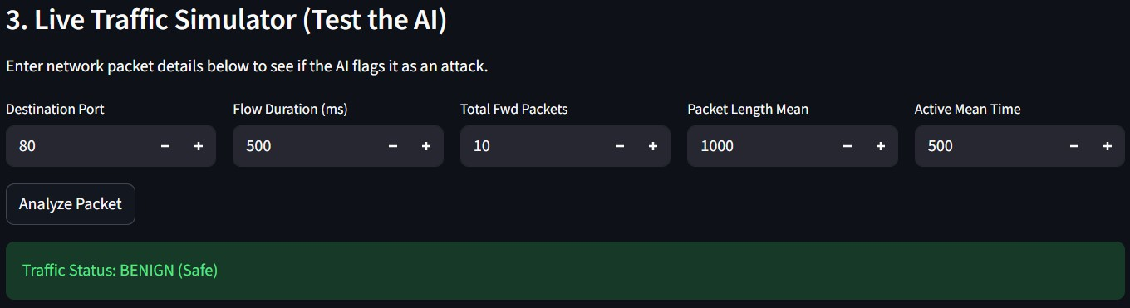
MODE: Real-time
TRAINING DATA SIZE: 80%
NUMBER OF TREES (RANDOM FOREST): 100

Slide 16

Certificate - Introduction to System Security

Slide 17

Certificate - Protection from Browser Attacks

Slide 18

Certificate - Securing Android Devices
‹#›

Slide 19
GitHub link
GitHub repository link: https://github.com/PERSONAL-PROJECTS- 2000/AINIDS
Streamlit app link: ainids-pdas.streamlit.app

Slide 20
Thank You!

